Slide 1

BSSE -Software Quality Engineering
Week-12 Lecture 23-24
Semester 6- Fall 2020

Slide 2
What is a Test Plan?
A TEST PLAN is a detailed document that describes the test strategy, objectives, schedule, estimation and deliverables and resources required for testing. Test Plan helps us determine the effort needed to validate the quality of the application under test. The test plan serves as a blueprint to conduct software testing activities as a defined process which is minutely monitored and controlled by the test manager.

Slide 3
Importance of Test Plan
Making Test Plan has multiple benefits
Help people outside the test team such as developers, business managers, customers understand the details of testing.
Test Plan guides our thinking. It is like a rule book, which needs to be followed.
Important aspects like test estimation, test scope, Test Strategy are documented in Test Plan, so it can be reviewed by Management Team and re-used for other projects.

Slide 4
How to write a Test Plan
You already know that making a Test Plan is the most important task of Test Management Process. Follow the seven steps below to create a test plan as per IEEE 829
Analyze the product
Design the Test Strategy
Define the Test Objectives
Define Test Criteria
Resource Planning
Plan Test Environment
Schedule & Estimation
Determine Test Deliverables

Slide 5
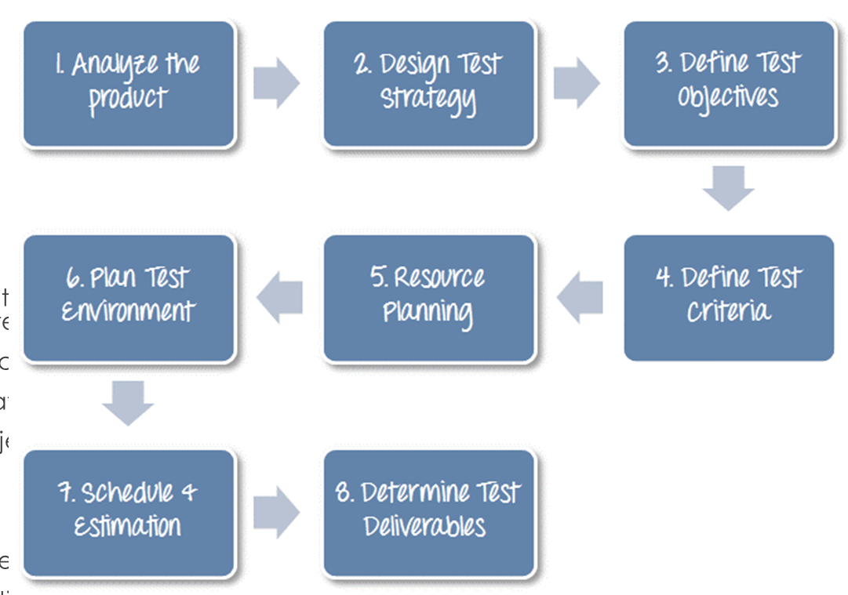

Slide 6
Step 1) Analyze the product
How can you test a product without any information about it? The answer is Impossible. You must learn a product thoroughly before testing it.
The product under test is a banking website. You should research clients and the end users to know their needs and expectations from the application
Who will use the website?
What is it used for?
How will it work?
What are software/ hardware the product uses?

Slide 7
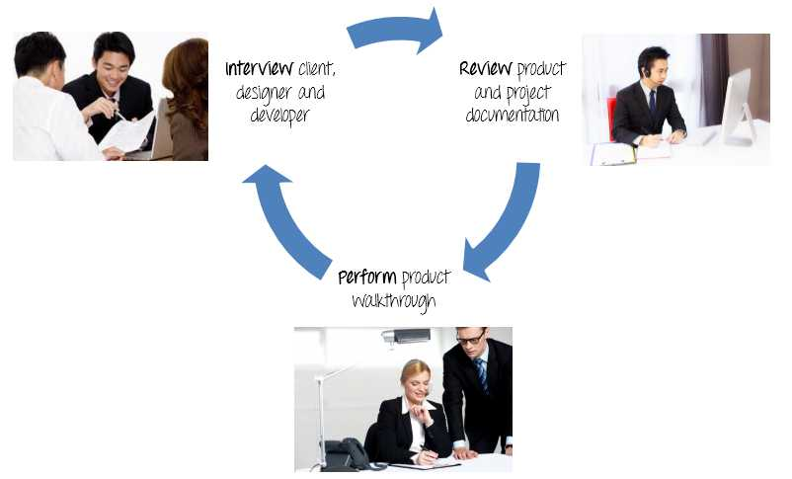

Slide 8
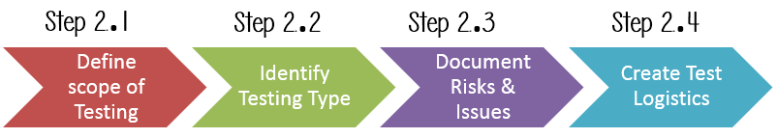
Step 2) Develop Test Strategy
Test Strategy is a critical step in making a Test Plan. A Test Strategy document, is a high-level document, which is usually developed by Test Manager. This document defines:
The project’s testing objectives and the means to achieve them
Determines testing effort and costs
Back to your project, you need to develop Test Strategy for testing that banking website. You should follow steps below

Slide 9
Step 2.1) Define Scope of Testing
Before the start of any test activity, scope of the testing should be known. You must think hard about it.
The components of the system to be tested (hardware, software, middleware, etc.) are defined as "in scope"
The components of the system that will not be tested also need to be clearly defined as being "out of scope."
Defining the scope of your testing project is very important for all stakeholders. A precise scope helps you
Give everyone a confidence & accurate information of the testing you are doing
All project members will have a clear understanding about what is tested and what is not

Slide 10
How do you determine scope your project?
To determine scope, you must –
Precise customer requirement
Project Budget
Product Specification
Skills & talent of your test team

Slide 11
Problem Scenario
The customer wants you to test his API. But the project budget does not permit to do so. In such a case what will you do?
Well, in such case you need to convince the customer that Api Testing is extra work and will consume significant resources. Give him data supporting your facts. Tell him if Api Testing is included in-scope the budget will increase by XYZ amount.
The customer agrees and accordingly the new scopes, out of scope items are
In-scope items: Functional Testing, Api Testing
Out of scope items: Database Testing, hardware & any other external interfaces

Slide 12
Step 2.2) Identify Testing Type
A Testing Type is a standard test procedure that gives an expected test outcome.
Each testing type is formulated to identify a specific type of product bugs. But, all Testing Types are aimed at achieving one common goal “Early detection of all the defects before releasing the product to the customer”

Slide 13
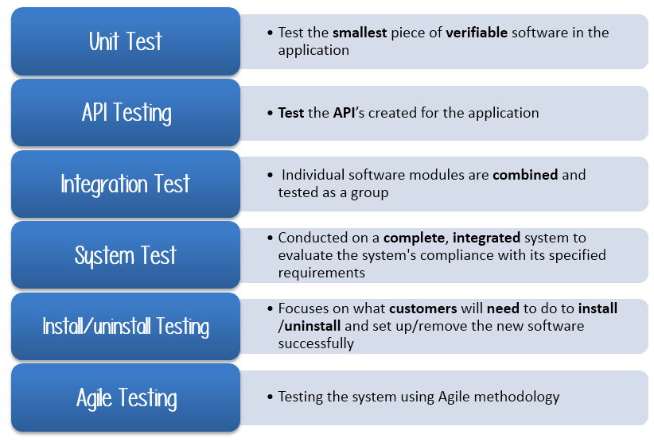

Slide 14
Step 2.3) Document Risk & Issues
Risk is future’s uncertain event with a probability of occurrence and a potential for loss. When the risk actually happens, it becomes the ‘issue’.
Risk | Mitigation
Team member lack the required skills for website testing. | Plan training course to skill up your members
The project schedule is too tight; it's hard to complete this project on time | Set Test Priority for each of the test activity.
Test Manager has poor management skill | Plan leadership training for manager
A lack of cooperation negatively affects your employees' productivity | Encourage each team member in his task, and inspire them to greater efforts.
Wrong budget estimate and cost overruns | Establish the scope before beginning work, pay a lot of attention to project planning and constantly track and measure the progress

Slide 15
Step 2.4) Create Test Logistics
In Test Logistics, the Test Manager should answer the following questions:
Who will test?
When will the test occur?
Who will test?
You may not know exact names of the tester who will test, but the type of tester can be defined.
To select the right member for specified task, you have to consider if his skill is qualified for the task or not, also estimate the project budget. Selecting wrong member for the task may cause the project to fail or delay.

Slide 16
Person having the following skills is most ideal for performing software testing:
Ability to understand customers point of view
Strong desire for quality
Attention to detail
Good cooperation
In your project, the member who will take in charge for the test execution is the tester. Base on the project budget, you can choose in-source or outsource member as the tester.
When will the test occur?
Test activities must be matched with associated development activities.

Slide 17

You will start to test when you have all required items shown in following figure

Slide 18
Step 3) Define Test Objective
Test Objective is the overall goal and achievement of the test execution. The objective of the testing is finding as many software defects as possible; ensure that the software under test is bug free before release.
To define the test objectives, you should do 2 following steps
List all the software features (functionality, performance, GUI…) which may need to test.
Define the target or the goal of the test based on above features
Let’s apply these steps to find the test objective of project
You can choose the ‘TOP-DOWN’ method to find the website’s features which may need to test. In this method, you break down the application under test to component and sub-component.

Slide 19
Step 4) Define Test Criteria
Test Criteria is a standard or rule on which a test procedure or test judgment can be based. There’re 2 types of test criteria as following
Suspension Criteria
Specify the critical suspension criteria for a test. If the suspension criteria are met during testing, the active test cycle will be suspended until the criteria are resolved.
Example: If your team members report that there are 40% of test cases failed, you should suspend testing until the development team fixes all the failed cases.

Slide 20
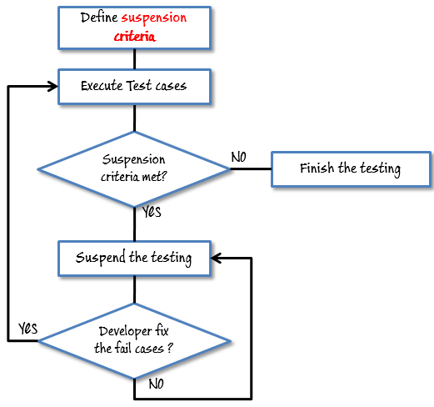

Slide 21
Exit Criteria
It specifies the criteria that denote a successful completion of a test phase. The exit criteria are the targeted results of the test and are necessary before proceeding to the next phase of development. Example: 95% of all critical test cases must pass.
Some methods of defining exit criteria are by specifying a targeted run rate and pass rate.
Run rate is ratio between number test cases executed/total test cases of test specification. For example, the test specification has total 120 TCs, but the tester only executed 100 TCs, So the run rate is 100/120 = 0.83 (83%)
Pass rate is ratio between numbers test cases passed / test cases executed. For example, in above 100 TCs executed, there’re 80 TCs that passed, so the pass rate is 80/100 = 0.8 (80%)

Slide 22
This data can be retrieved in Test Metric documents.
Run rate is mandatory to be 100% unless a clear reason is given.
Pass rate is dependent on project scope, but achieving high pass rate is a goal

Slide 23
Step 5) Resource Planning
Resource plan is a detailed summary of all types of resources required to complete project task. Resource could be human, equipment and materials needed to complete a project
The resource planning is important factor of the test planning because helps in determining the number of resources (employee, equipment…) to be used for the project. Therefore, the Test Manager can make the correct schedule & estimation for the project.

Slide 24
No. | Member | Tasks
1. | Test Manager | Manage the whole project Define project directions Acquire appropriate resources
2. | Tester | Identifying and describing appropriate test techniques/tools/automation architecture Verify and assess the Test Approach Execute the tests, Log results, Report the defects. Tester could be in-sourced or out-sourced members, base on the project budget For the task which required low skill, I recommend you choose outsourced members to save project cost.
3. | Developer in Test | Implement the test cases, test program, test suite etc.
4. | Test Administrator | Builds up and ensures Test Environment and assets are managed and maintained SupportTester to use the test environment for test execution
5. | SQA members | Take in charge of quality assurance Check to confirm whether the testing process is meeting specified requirements

Slide 25
System Resource
For testing, a web application, you should plan the resources as following tables:
No. | Resources | Descriptions
1. | Server | Install the web application under test This includes a separate web server, database server, and application server if applicable
2. | Test tool | The testing tool is to automate the testing, simulate the user operation, generate the test results There are tons of test tools you can use for this project such as Selenium, QTP…etc.
3. | Network | You need a Network include LAN and Internet to simulate the real business and user environment
4. | Computer | The PC which users often use to connect the web server

Slide 26
Step 6) Plan Test Environment
What is the Test Environment
A testing environment is a setup of software and hardware on which the testing team is going to execute test cases. The test environment consists of real business and user environment, as well as physical environments, such as server, front end running environment.
How to setup the Test Environment
Back to your project, how do you set up test environment for a project?
To finish this task, you need a strong cooperation between Test Team and Development Team

Slide 27
You should ask the developer some questions to understand the web application under test clearly. Here’re some recommended questions. Of course, you can ask the other questions if you need.
What is the maximum user connection which this website can handle at the same time?
What are hardware/software requirements to install this website?
Does the user's computer need any particular setting to browse the website?

Slide 28
Step 7) Schedule & Estimation
In the article Test estimation, you already used some techniques to estimate the effort to complete the project. Now you should include that estimation as well as the schedule to the Test Planning

Slide 29
Task | Members | Estimate effort
Create the test specification | Test Designer | 170 man-hour
Perform Test Execution | Tester, Test Administrator | 80 man-hour
Test Report | Tester | 10 man-hour
Test Delivery |  | 20 man-hour
Total |  | 280 man-hour

Slide 30
Then you create the schedule to complete these tasks.
Making schedule is a common term in project management. By creating a solid schedule in the Test Planning, the Test Manager can use it as tool for monitoring the project progress, control the cost overruns.
To create the project schedule, the Test Manager needs several types of input as below:
Employee and project deadline: The working days, the project deadline, resource availability are the factors which affected to the schedule
Project estimation: Base on the estimation, the Test Manager knows how long it takes to complete the project. So he can make the appropriate project schedule
Project Risk : Understanding the risk helps Test Manager add enough extra time to the project schedule to deal with the risks

Slide 31
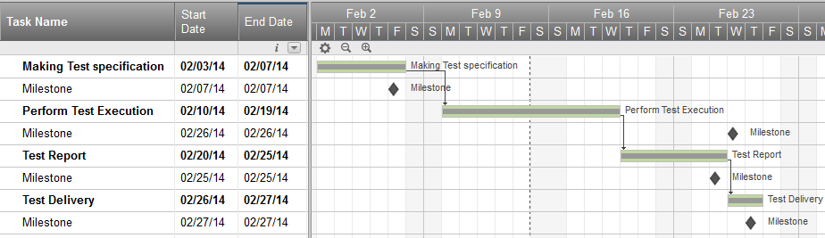

Slide 32

Step 8) Test Deliverables
Step 8) Test Deliverables
Test Deliverables is a list of all the documents, tools and other components that has to be developed and maintained in support of the testing effort.
There are different test deliverables at every phase of the software development lifecycle.

Slide 33
Test deliverables are provided before testing phase.
Test plans document.
Test cases documents
Test Design specifications.
Test deliverables are provided during the testing
Test Scripts
Simulators.
Test Data
Test Traceability Matrix
Error logs and execution logs.

Slide 34
Test deliverables are provided after the testing cycles is over.
Test Results/reports
Defect Report
Installation/ Test procedures guidelines
Release notes

